Slide 1
Finance to Help Your Community Grow
Clann Credo – Community Loan Finance
Tracey Hannon
Social Finance Executive – Western Region
Notes:
THANK HOSTS FOR OPPORTUNITY TO SPEAK

Slide 2
Presentation Overview
CLANN CREDO – COMMUNITY LOAN FINANCE
EXAMPLES OF COMMUNITY FINANCE
HOW TO APPLY FOR SOCIAL FINANCE
EVALUATION PROCESS
Notes:
- NOTE FOR SPEAKER – Good to say three times what your key message is, at the beginning, middle and end. KEY MESSAGE IS THERE IS – any community based organisation that is working to enhance their community and has the ability to repay a loan can borrow from Clann Credo, THERE IS NO SCARCITY OF FUNDS FOR Community loan finance

Slide 3
What is Social Finance?
Repayable Loan Finance
Socially Minded Investors
Social Outcome AND Repayment Capacity
Notes:
SOCIAL FINANCE IS INVESTMENT IN COMMUNITIES BY INVESTORS THAT WANT A SOCIAL RETURN ASWELL AS A FINANCIAL RETURN, OUR SOCIALLY MINDED INVESTORS WANT TO Help organisations achieve their social, economic and financial potential.

Slide 4
Clann Credo Lending
Notes:
CLANN CREDO HAS BEEN INVESTING IN COMMUNITES ACROSS IRELAND FOR 20 YEARS, THERE IS CURRENTLY 22 MILLION LENT OUT, THIS SLIDE SHOWS THE BREAKDOWN OF THIS MONEY BY SECTOR

Slide 5
Clann Credo Loan Finance
Matching Term Loan Finance
Bridging Finance to Secured Grants
Term Loan Finance for Capital Expenditure
Term Loan Finance for Working Capital
Notes:
Groups receive Social Finance for various purposes….

Slide 6
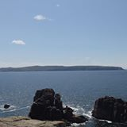
Comharchumann Oileán Árainn Mhóir
Established in 2001 to provide for the social, cultural and economic needs of the island community.
Provides childcare, sports facilities including gym and water sports, internet, training courses, meals on wheels, bingo, organisation of local events, drama group
CSP funded staff including a Manager and Youth Development Worker
5 separate projects over three years – computer equipment, sailing equipment/training and refurbishment of community centre
Requirement for bridging finance against funding from LEADER and Rionn na Gaeltachta
Term loan finance to make up the shortfall in funds

Slide 7
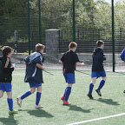
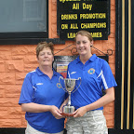
Manorhamilton Rangers FC
Manorhamilton Rangers FC
Purchase of land to develop sporting facilities.
Term Loan over 15 year period.
Repayment combination of income from the club and fundraising
Social benefit – activities for all ages

Slide 8
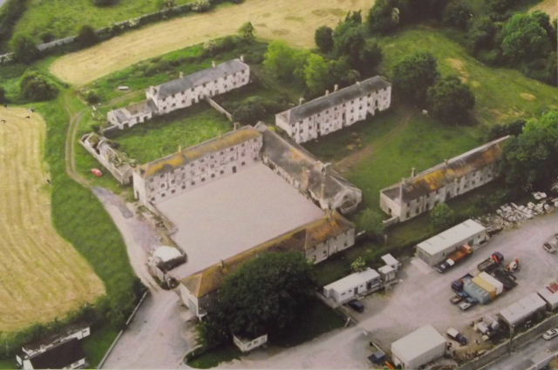
Irish Workhouse Centre - Galway
Facility was mainly funded by RDP Grant
Work cost €233,947
Own Funds €33,947
Requirement for €200,000 facility from CCL
Restoration of the workhouse in Portumna – redevelopment of the schoolroom, waiting room, girls dormitories and offices.
The centre now includes an audio visual room, interpretative centre, reception and offices for SE Galway IRD.

Slide 9
Ionad Cuimhneacháin na N-Imirceach | Coiste Páirc Chill Chiarán
Loughrea FRC | Coiste Ceantar na nOilean
Galway Sea Scouts | Tir na Fhia NS
Aughrim Community Development | Comhar Chuigeal Teo
Ballinasloe Community Childcare | Comharchummann Fuinimh Oileann Aran Teo
Ballybane Community Resources | Cumann Michael Breathneach
Ballygluinn Railway Restoration | EQUAL Ireland
Caltra Community Development | Galway Travellers Movement (First Class Insulation)
Barna FC | ITTT Inverin
Barna GAA | Mountbellew Vintage Club
Sportlann Naomh Anna | Mullagh GAA
Claregalway Handball Club | Oughterard Courthouse and Restoration Project
Clifden Chamber of Commerce | Portumna Town FC
Club Judo Leitir Mealláin | Rosscahill Killainn Pavement Committee

Slide 10
No Application Form
Notes:
HOW TO ACCESS LOAN FINANCE, CALL US UP OR CONTACT US THROUGH OUR WEBSITE, TELL US ABOUT YOUR PROJECT OR PLANS, WE WILL PREPARE A REPORT ON YOUR APPLICATION FOR APPROVAL BY OUR EVALUATION COMMITTEE. WE WILL REQUEST DETAILS ABOUT YOUR GROUPS ACTIVITIES, DETAILS ON THE GOVERNANCE OF YOUR ORGANISATION AND VOLUNTARY BOARD MEMBERS, HISTORIC FINANCIAL ACCOUNTS, DETAILS OF GRANTS AND DEMONSTRATION OF YOUR REPAYMENT CAPACITY.

Slide 11
Community Impact⁺ Loans- Affordable Rates
No Personal Guarantees
Early Repayment Options
Community Impact⁺ Loan¹
 | Loan Amount | Typical Annual Interest Rate | Typical Arrangement Fee
Community Impact⁺ Term Loan: 5+ years to 15 years | €30,000 to €500,000 | 4.95% | None
Community Impact⁺ Term Loan: 2 to 5 years | €30,000 to €500,000 | 6% | None
Community Impact⁺ Bridging Loan: up to 2 years | €30,000 to €500,000 | 6% | 1%
Community Impact Term/Matching Loan | €10,000 to €30,000 | 6.75% | None
€150 Voucher to spend on The Wheel’s Training Programmes and Expert Services;
FREE Financial Health Check; and
FREE places on invite only, Specialist Workshops for your volunteers and staff.
Notes:
As well as affordable interest rates, our Community Impact⁺ Loan comes with; No Personal Guarantees: Because we recognise the contribution that community leaders and volunteers make, we do not ask for personal guarantees.
Early Repayment Options: With a Clann Credo loan, you can make extra repayments and clear your loan early with no penalty fees, in fact you will save on interest. This applies to all loans, including fixed interest rate loans.
In addition to these competitive terms and interest rates, every Community Impact⁺ borrower receives: WHEEL, ETC

Slide 12
Why chose a Community Impact Loan?
In-depth Knowledge of the Community Sector
Affordable Interest Rates
Regionally-based Staff
Understanding of different Grant Programmes
- Community Leader Loan, Sports Capital etc
Track Record of over 20 Years
Notes:
Clann Credo has an experienced team that understands your needs and the unique financing requirements of community organisations. With a Community Impact⁺ Loan you get competitive interest rates from as little as
4.95% p.a. on Term Loans of more than 5 years; 6% p.a. Fixed on Bridging Loans; and 6% p.a. Fixed on all Term Loans of 5 years or less.
Clann Credo has staff in every region, South, Midlands, Border, West and East, who will assist you throughout the application process.
Community based organisations face many challenges, but …. Accessing loan finance need not be one of them, In fact any community based organisation that is working to enhance their community and has the ability to repay a loan can borrow from Clann Credo.

Slide 13
Our People
REGIONALLY BASED STAFF
West/North West:
Tracey Hannon
Lower Main Street
Foxford, Co Mayo
T: 094 906 0679 / 087 6488390
North & East:
Jennifer Hennessy
T: 01 400 2100 / 087 9556721
Midlands:
Roisin Mulligan
T: 01 400 2100 / 086 3098098
South:
Susan Gallagher
T: 021 462 1182 / 087 7388391
VOLUNTARY BOARD AND COMMITTEES
BOARD
Colin McCrea (Chair); Jerry Butler; Gary Brennan; Magdalen Fogarty (Founder); Tom Finlay ; Emer Ní Bhrádaigh; Grace Redmond; Jim Rourke; Paul Sullivan; Don Thornhill.
EVALUATION COMMITTEE
Paul Sullivan; Magdalen Fogarty; Martin Coggins, Sheila Fox; Jerry Kivlehan; Tom Finlay; Gary Brennan.
PROJECT SUPPORT COMMITTEE
Jim Rourke; Colin McCrea; Emer Ní Bhrádaigh; Ann Clarke; Pat Leogue; Grace Redmond; Ger Marshall.

Slide 14
Thank You Questions?

